Slide 1
STUDENT ADMINISTRATION SYSTEM
GROUP 12

Slide 2
Executive summary
Overview
  Modern and secure student management system that simplifies school administration.
Reason
  Manual systems for school management is inefficient, can cause errors, and leads to poor communication between staff, students, and parents.
Benefits
  Reduces long term costs, reduces manual work, improves accuracy, and enhances efficiency.

Slide 3
Problem Statement
Manual attendance and grading is time taking.
Paper based record keeping is expensive.
Sending newsletters through students is unreliable.
Fragile data storage due to lack of backup.

Slide 4
Core features
Role based access control.
Academic performance & attendance tracking.
Timetable management.
Report generation.
Parent portal.
AI Chatbot.

Slide 5
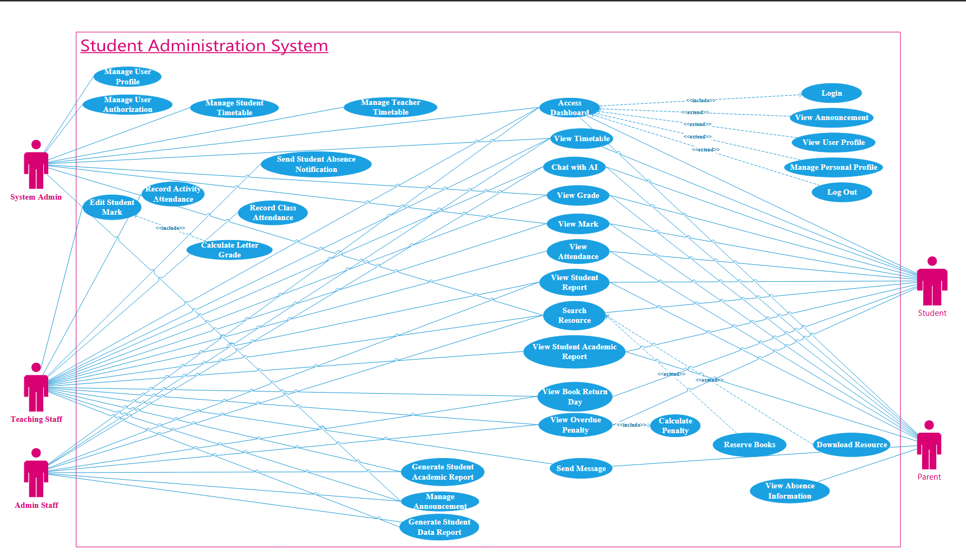
Functional overview

Slide 6
Quality Considerations
Technical
  Component based architecture.
  Automated CI/CD pipeline.
Performance
  Support 1000+ concurrent users.
  Asset compression and lazy loading.
Dependability
  Automatic backups.
  99.99% uptime.

Slide 7
project constraints
Network access.
Programming language & resources.
Implementation and maintenance cost.
Training & onboarding.

Slide 8





Technology stack
React.js
Node.js
OpenAI
PostgreSQL
Amazon Web Services

Slide 9
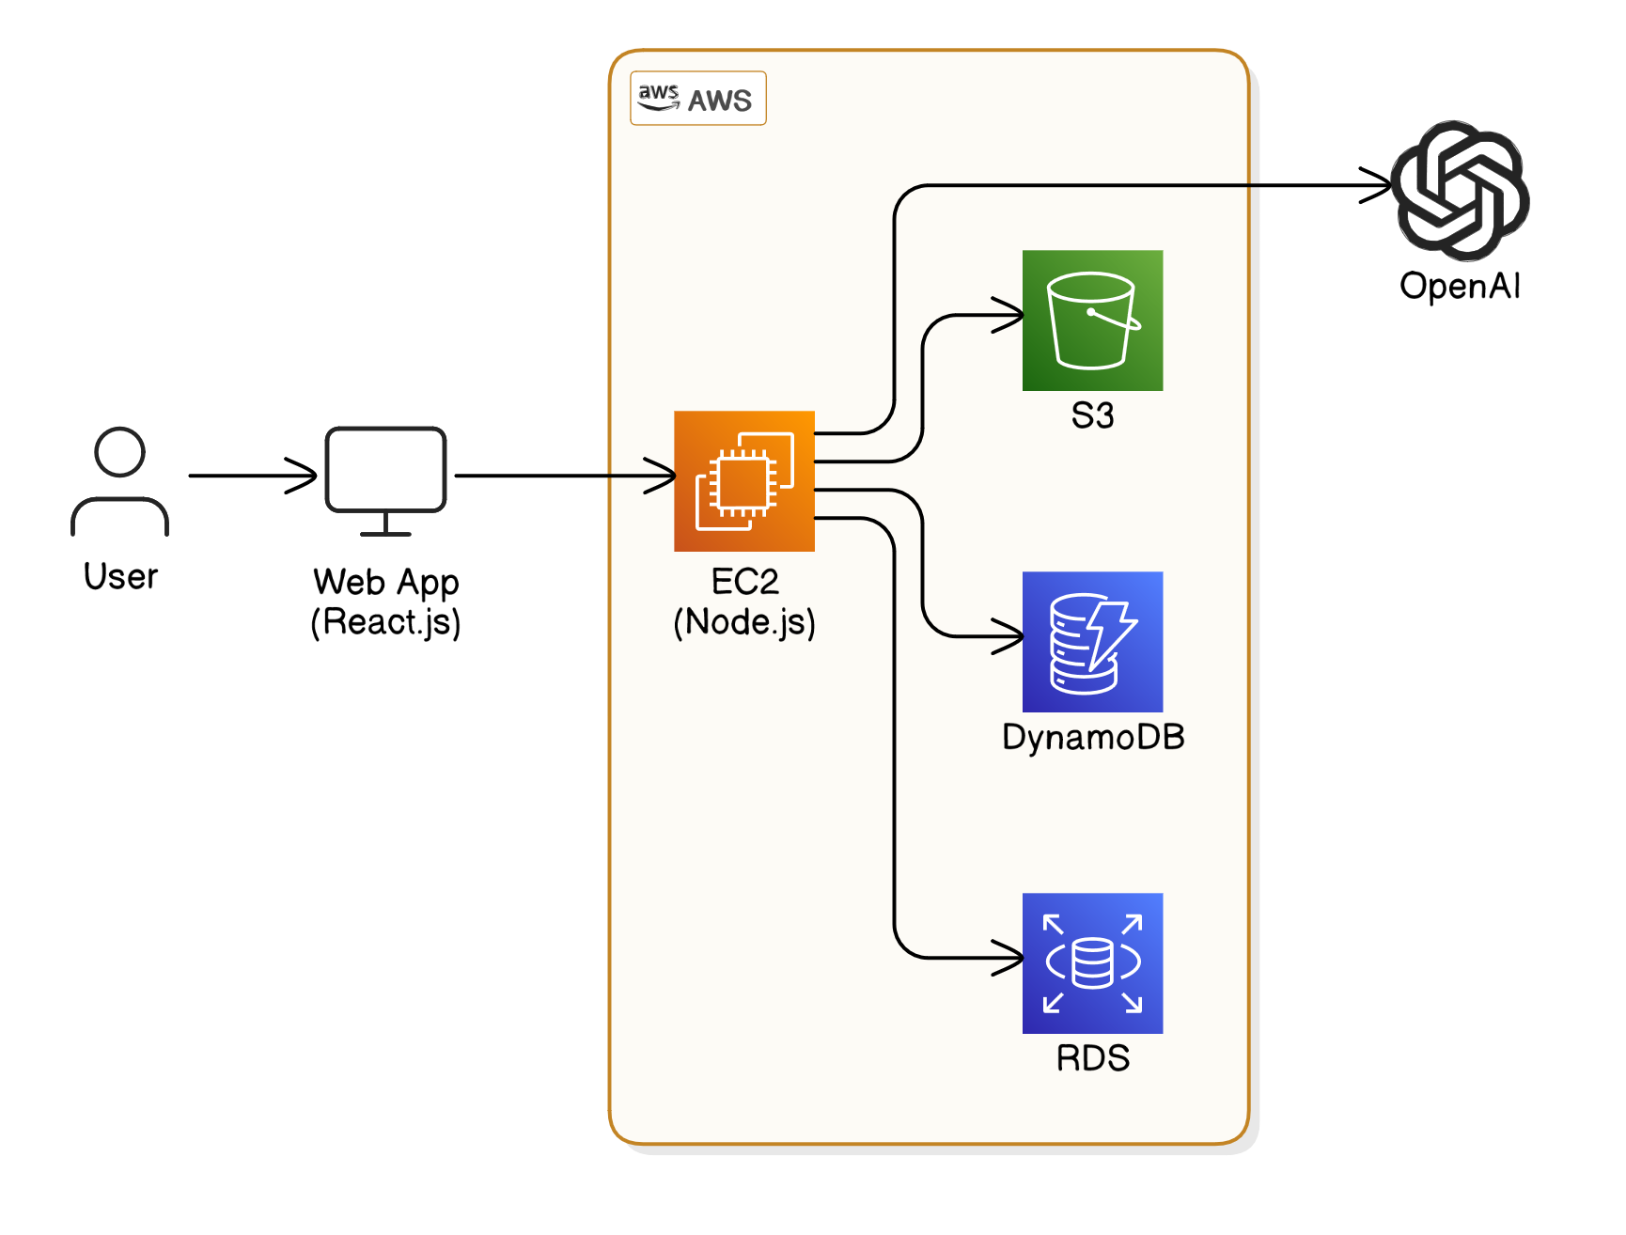
Architecture

Slide 10
Cost benefit analysis
Estimated Costs
  System development cost $120,000.
  Recurring costs (depends on usage, ~$5,000/month).
  Maintenance costs $15,000/year.
Benefits
  Money saved from printing papers.
  Time saved due to automation.
  Time saved due to fewer human errors.
  Quicker and more accurate student management.

Slide 11
Project Timeline
Task Name | Duration
Planning | 1 month
Designing | 1 month
Development | 4 months
Testing | 1 month
Deployment | 2 months

Slide 12
Summary
SAS will save money and time in the long term.
SAS uses modern and secure technologies.
SAS puts the user first (AI chatbot).
SAS features will attract new students and staff.

